Slide 1
Environmentally Responsible Business: Policies & Practices
Presented By:
Ashik , Nasir & Yash

Slide 2
Topic Covers:-
Introduction
Policies and Practices in ERBS
Lean Impact on Green
Environmental Areas Covered
Breadth of Environmental Policies (Areas Covered)
Depth of Environmental Policies (Intensity of Coverage)
Length of Environmental Policies (Duration of Coverage)
Green Values in Practice
Green Practice: A Balancing Act

Slide 3
Key points :
◾ An overview of what makes an environmentally responsible business is presented.
◾ A Green translation of Green IT strategies into actionable policies is addressed.
◾ Understanding and insights from survey data are used to shape environmental policies of a business.
◾ Discusses and analyzes the goals that need to be defined by an organization in order to adopt green policies.
◾ Addresses the importance of renewable energy sources in practicing Green IT
◾ Discusses company policies on usage of nonrenewable resources consumed in the company premises.
◾ Defines guidelines for providing recycle facilities for biodegradable materials.

Slide 4
Introduction:
A is chapter discusses the policies & practices that result from the development of the Green enterprise strategies .Such policies & practice are an important and integral part of an overall Green initiative of an enterprise. Development of green policies equips an organization to handle the inevitable resulting challenges when changing the way it currently operates. Green business policies and corresponding practices, as discussed in this chapter are also related to a lean business because green policies align themselves with the lean business principles and pracatices. For example, an organization can change its practices to reduce the slack in its business processes in response to a lean business initiative aimed at reducing waste. Such lean initiative would not only reduce waste due to reengineered activities but also reduce the organization’s carbon footprint. Alternatively, an organization might decide to improve its product design in response to the changes in customer preferences in terms of green products and services. Is redesign of product will also help to reduce the emissions as there will be operational efficiency embedded in the product as also enhanced customer satisfaction with the use of the product. as, green policies as discussed here are closely associated with the business itself and are an integral part of the business. Attempts of converting policies into practices through the green programs may also result in occasional modification of the policies themselves. is should be anticipated and provisioned for in any good policy development schedule.

Slide 5
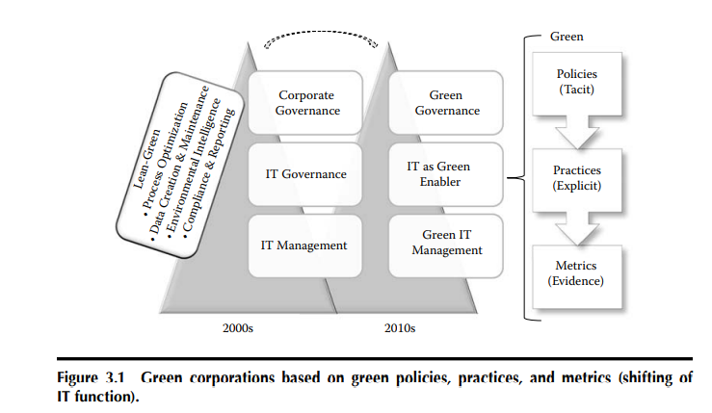
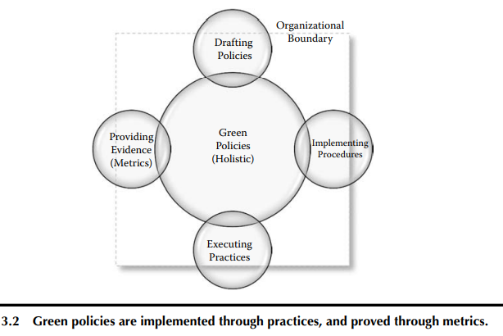

Slide 6
Policies and Practices in ERBS:
In practical terms, a policy can be a high-level document that spells out what the organization will (and will not do) when it comes to business decision making. Green policies ensure that the decision making in the organization has carbon reduction as its integral component. green policies are created with significant input from the senior management of the organization and are embedded into the business strategy of the company. While the policies state, through detailed statements what is implied in the ERBS, the green practices are the implementation of the policies (see Pratt 2009 for related discussion). Together these policies and practices drive the environmentally responsible activities of the organization. For example, these policies and practices help in ascertaining both internal and external decisions made by the organization. Therefore, these policies and practices need to be carefully drafted, validated,and embedded within the strategy of the organization.

Slide 7
There are various types of environmentally responsible business policies.
Policies to influence attitudes of staff towards carbon emissions : Awareness and positive attitude amongst the employees and users within the organization about carbon emissions can bring about substantial changes in the way the organization operates. Twenty-seven percent o fthe respondents “agree” a nd (18%) “strongly agree” to having policies that raise awareness of green issues among people. policies that influence the staff requires training plans and budget as well as support from human resource.
Policies for use of renewable energy (e.g., solar, nuclear): Different sources of renewable energy such as solar power grids, nuclear plants, and wind farms are increasingly coming into play. Issues around the solar cells, their life, and sunlight were cited by organizations using solar energy. In the case of wind power, consistency of wind for continuous power generation was raised as an issue and for geothermal energy, the management of pollutants was cited. Further analysis of the survey data indicates that decision makers and quality managers strongly believe in alternative, or renewable energy sources, but cost appears to be a big constraint in the use of alternate source of energy.

Slide 8
Policies for optimizing energy consumption in all business processes: Business processes can vary from utilizing low level resources such as paper to highly required resources such as electricity. In carrying out business processes, a lot of energy is wasted and that energy cannot be recycled at many times. Hence, policies to optimize energy consumption in business processes should be incorporated in business strategy.
Policies for adopting and implementing recycling of equipment: Theses policy reduces the disposal of equipments which may still be functioning. is survey response also indicates that if waste cannot be prevented then as many of the materials as possible should be recovered through recycling. Policy for adopting and implementing recycling of equipments will recover usable materials and components, postpone replacement of working equipment, and increase reuse awareness.

Slide 9
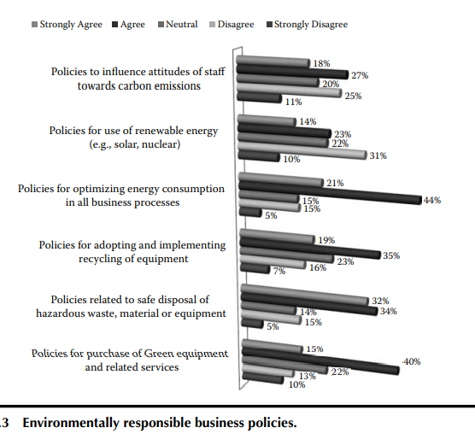
Policies related to safe disposal of hazardous waste, material or equipment: Disposal of hazardous and harmful waste particularly out of computing equipment requires careful policy consideration, is policy should also accompany promotion of environmental awareness that will also encourage change in attitude toward waste minimization, reuse, and recycle. amount of waste generated from any organization is directly proportional to the business activities.
Policies for purchase of Green equipment and related services: A is policy requires the organization to devise standards around procuring new equipments or buying new services from external parties. Such environmentally responsible purchasing for IT products is being incorporated into purchasing programs of many private and public sectors. an environmental objectives form part of the objectives within government procurement programs

Slide 10
Environmental Areas Covered
Environmental Policies and their practices can be viewed from three different angles:-
The breadth of coverage
The depth at which they operate, and
The length of time they are influential within the organization.

Slide 11
BREADTH OF ENVIRONMENTAL POLICIES (AREAS COVERED)
This dimension covers the various areas of organization, its departments, subsidiaries, and partners.
It includes coverage of building, infrastructure, and operative environment.
The need to consider the overall organization and its entire breadth in terms of green IT includes:
Creation of green programs,
Analysis,
Modeling and simulation tools in managing environmental risks and improving accuracy of measurements.
This breadth of coverage also increases the risks associated with the green transformation and, therefore, requires greater coordination amongst the four dimensions of change and additional upfront resources.

Slide 12
DEPTH OF ENVIRONMENTAL POLICIES (INTENSITY OF COVERAGE)
This dimension focuses on the depth of environmental responsibilities of an organization.
Depth is an indicator of intensity with which the policies are implemented and practised by the organization.
A deep practice of policies in large organizations is well supported by tools for
Eco-management,
Operating on dedicated systems, and
Reporting of carbon performance for single and collaborative business processes.

Slide 13
A depth of coverage for each process includes:
Detailed description,
Mapping,
Responsibilities, and
Execution of roles, deliverables, activities, and tasks within the organization.
It facilitates audits and feedback to the same process in greater detail.
Deep coverage of green policies also enables coverage of Environmental Intelligence, its management and sharing of knowledge.

Slide 14
LENGTH OF ENVIRONMENTAL POLICIES (DURATION OF COVERAGE)
> This dimension focuses on the length of time in terms of green IT policies formation and practice.
Sustainable policies are the policies that enable a business to sustain itself for a long period of time.
The longer a business stays in 'business', the better are its chances of economic success.
The correlation between environmental sustainability and economics can be established through time.
Green business advantage can be driven by the potential of the relationship between success and time.

Slide 15
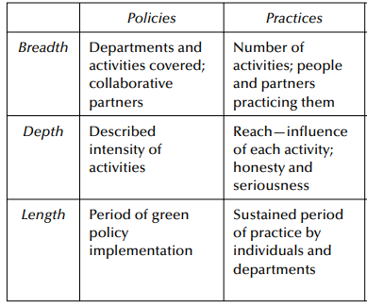
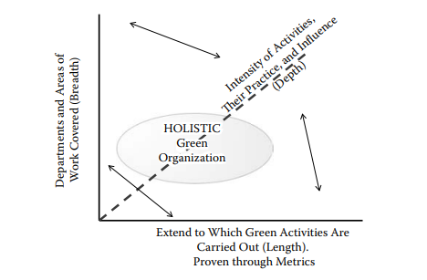
When time is incorporated in green policies, it is important to consider the longevity of the green IT initiative as well.
The transformation of green state over a period of time requires consideration of 'length' factor, which should refer to the length of the organization itself.

Slide 16
GREEN VALUES IN PRACTICE
The approach to convert the green policies into practice is through a combination of training, usage, incentives, and introduction of penalty risks.
Short-term operational strategies are easy to implement. Some examples of converting short-term policies into practice include:
Computing power management
Use a blank screen saver
Limited printing
Reuse and recycling of equipment

Slide 17
GREEN PRACTICE: A BALANCING ACT
Implementing green values and green costs in green policies may be troublesome occasionally.
There is a need to reflect their balance as their policies are drafted.
The balancing act, in practice, requires consideration of both IT and non-IT assets of the organization.
A balanced policy for green IT accepts the profit and costs as prime necessities for business. Profit-costs form a part of balancing act.
Green practice also involves length-breadth-depth assets of the organization.

Slide 18
Thank You!!

